Slide 1
STDISCM P3
S12 - DIMAGIBA, GARCIA, PARK, SILLONA

Slide 2
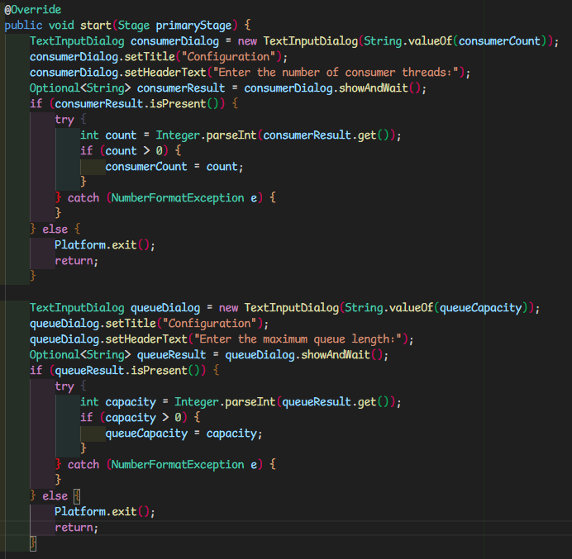
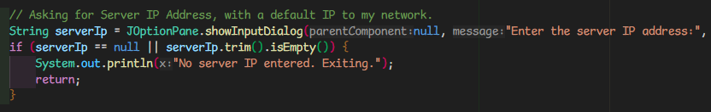
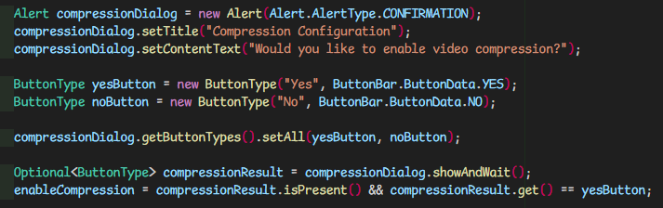
User Input
The user is asked to provide the necessary details to run the program (IP address, no. producer threads, video location, no. of consumer threads, max queue length) with approriate input validation

Slide 3
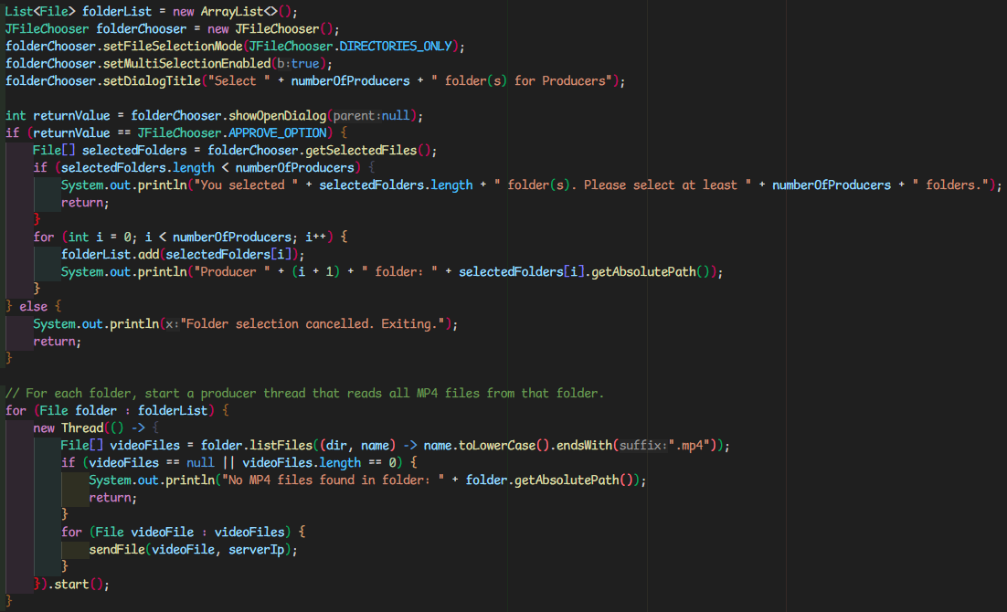
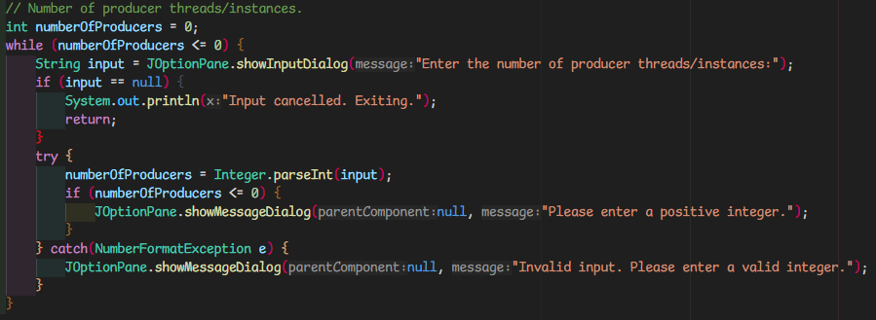
User Input

Slide 4
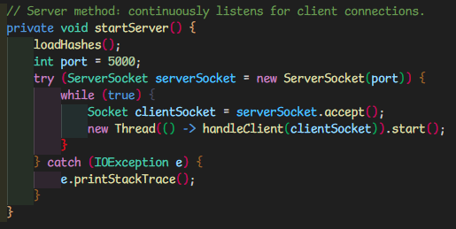


Networking
The server continuously listens on port 5000 for incoming client connections
Client connection with sockets

Slide 5
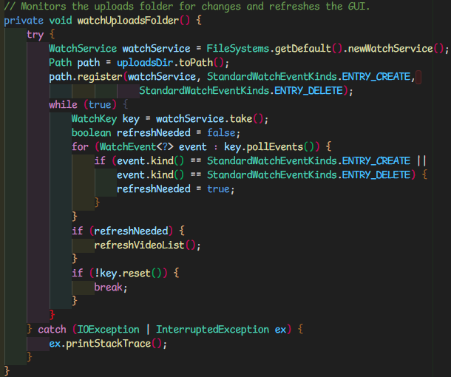
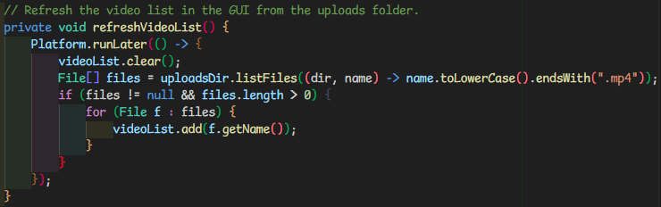
GUI
The uploads folder is monitored for any changes
GUI is updated accordingly

Slide 6
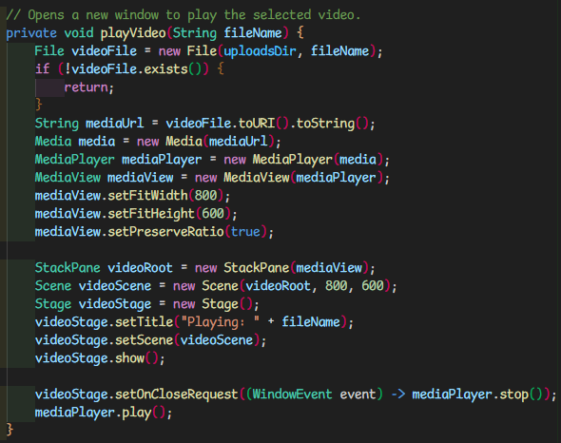
GUI
JavaFX MediaPlayer / MediaView is used to play a selected video

Slide 7
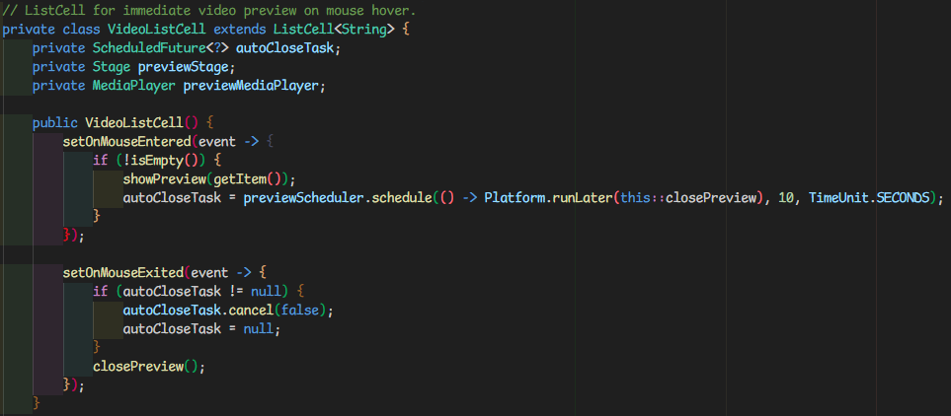
GUI
Listener for on-hover event

Slide 8
Preview
Listener for on-hover event

Slide 9
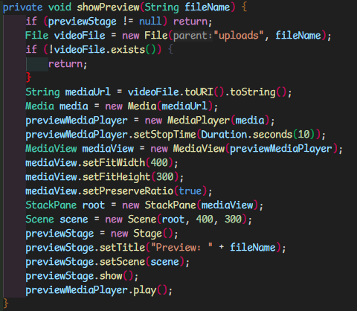
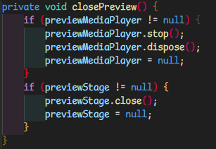
Preview
Displaying 10 second preview with JavaFX MediaView
Closing preview

Slide 10

Queuing Details
Files are simultaneously uploaded to a queue on the server
Any files that are sent to the server when the queue is full are simply dropped as indicated server-side

Slide 11
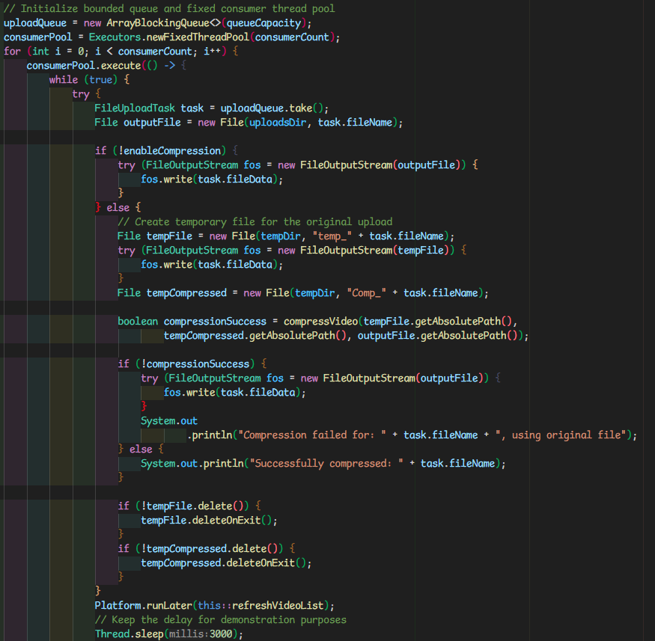
Queuing Details
A consumer thread simply takes the first options from the queue to be written onto the server

Slide 12
Producer and Consumer Concepts Applied

Slide 13
Asynchronous Communication
The server continuously accepts connections even through communication with other clients and the server’s own consumer processes

Slide 14
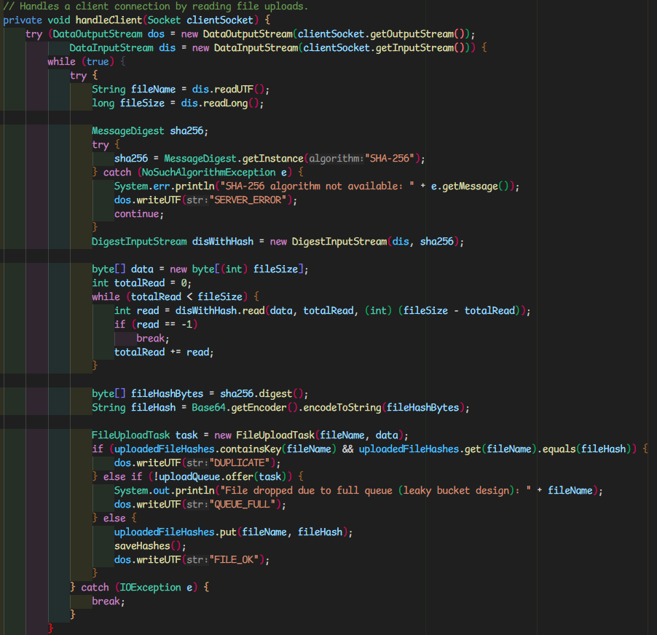
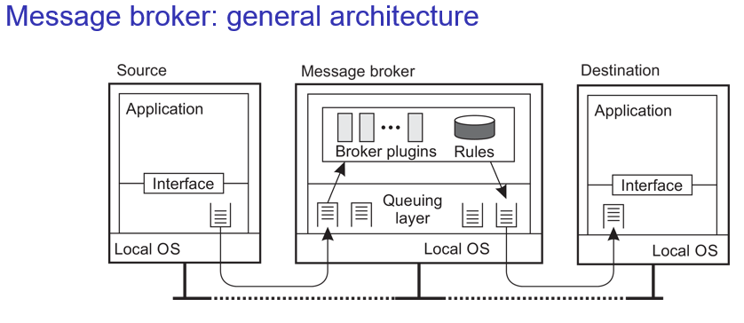
Message-oriented Middleware (Message Broker)
Within the server, there is a simple implementation of handling incoming messages and storage into queues

Slide 15
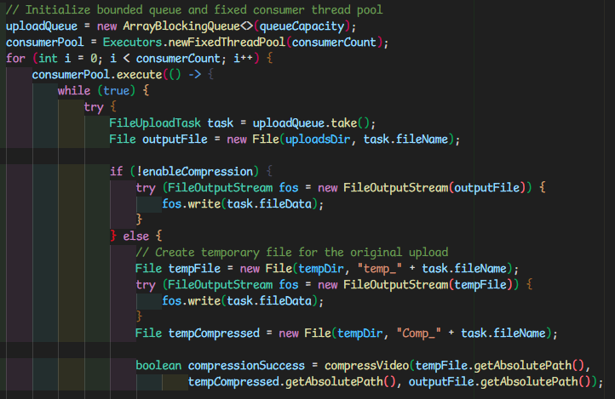
Message-oriented Middleware (Queueing)
The placement of incoming videos into a queue allows for separation between file reception (handleClient) and file processing (consumer threads)

Slide 16
Synchronization Mechanisms - Blocking Queue
BlockingQueue inherently synchronizes access to the queue between multiple threads, ensuring that producers and consumers don’t interfere with each other
It prevents race conditions by ensuring that only one thread at a time can modify or access the state of the queue

Slide 17
Bonus Features

Slide 18
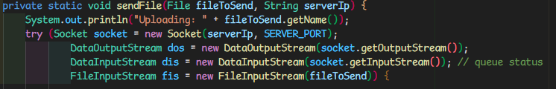
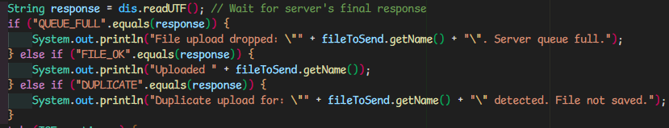
The consumer program can tell the producer processes that the queue is full
The producer process can wait for server’s response on if file made it to the queue

Slide 19
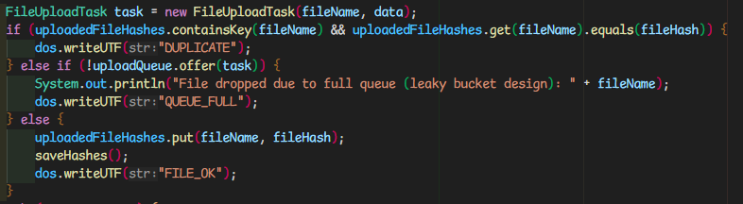
The consumer program can tell the producer processes that the queue is full
Server sends status here

Slide 20
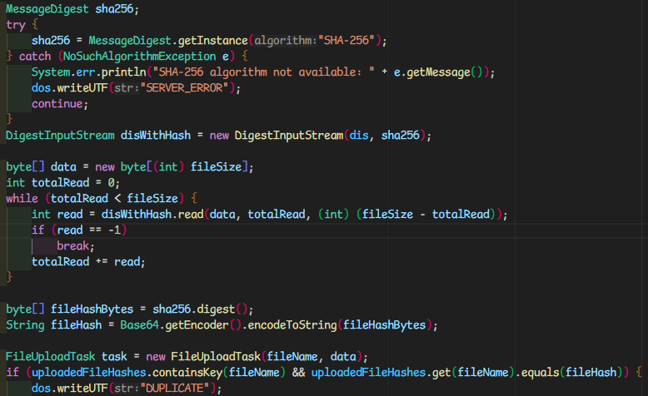
Duplication Detection
hashmap of file name and hash is generated from upload, if there is a match in database the file is dropped and marked as a duplicate

Slide 21
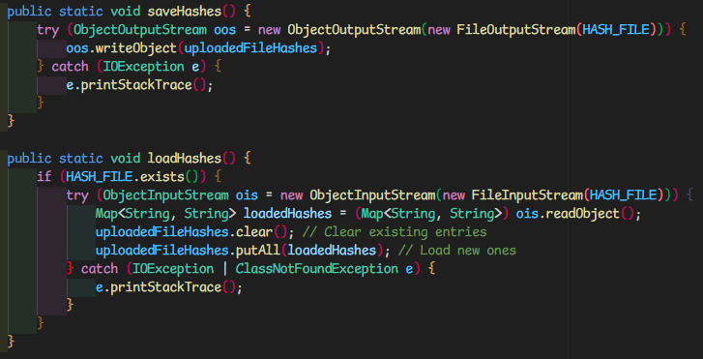
Duplication Detection
hashmap is saved to a file server-side to persist even after server is terminated

Slide 22
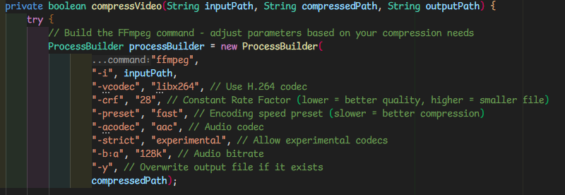
Duplication Detection
The server uses ffmpeg to compress videos. In order to avoid cases where UI tries to read a video that hasn’t finished compression process, files are kept in temporary storage until completion then compressed video is sent to uploads destination

